Slide 1



WEB-BASED SAFETY EYEWEAR DETECTION SYSTEM IN WORKPLACE
USING MACHINE LEARNING
by Najla Athirah binti Mohd Nazri (1813322)
Supervised by Assoc. Prof. Dr. Nurul Fariza Zulkurnain
ECE Department, Kulliyyah of Engineering IIUM

Slide 2





CONTENT
Introduction
Literature
Review
Methodology
Result & Demonstration
Conclusion & Future Work
Problem Statement
Objective
Flowchart
Proposed Method
Theory
Method comparison

Slide 3
CONTENT
Introduction
Problem Statement
Objective

Slide 4

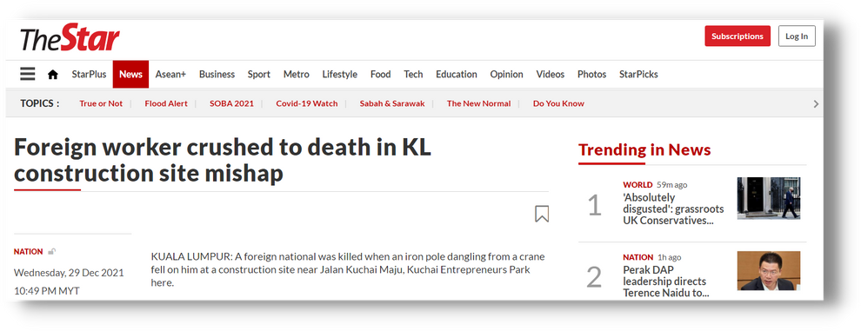




PROBLEM STATEMENT
Accidents occurence
Ineffective
monitoring system
Current techniques
Trade off between
speed and accuracy
Current techniques
Focuses on regular
spectacles

Slide 5


OBJECTIVES
ANALYZE
ALGORITHMS
DEVELOP DETECTION SYSTEM
DEPLOY
MODEL
To analyze the different types of algorithms for safety eyewear detection based on their speed and accuracy
To develop an algorithm for safety eyewear detection that is suitable to be applied in the construction industry using machine learning
To deploy the trained model to a web application to be used in the construction site

Slide 6
CONTENT
Introduction
Literature
Review
Problem Statement
Objective
Theory
Method comparison

Slide 7

OBJECT DETECTION
LITERATURE
REVIEW
A task in computer vision that works with detecting instances of visual objects of a particular class in digital images

Slide 8
EYEWEAR DETECTION
LITERATURE
REVIEW
A task in computer vision that works with detecting instances of safety eyewear of a particular class in digital images

Slide 9

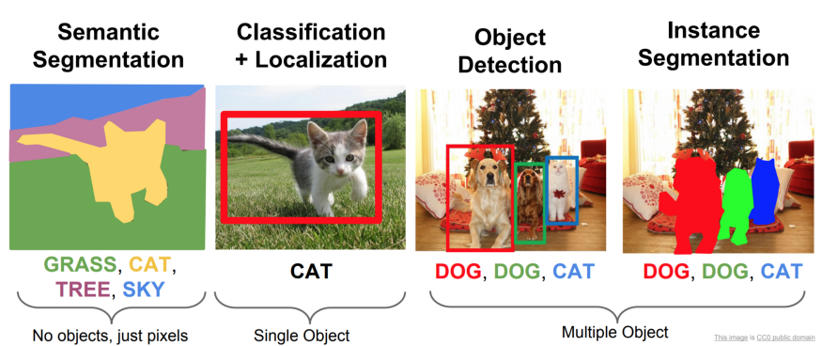
LITERATURE
REVIEW
OBJECT DETECTION

Slide 10
Unique features extracted based on the pixels detected
OBJECT DETECTION

Slide 11
2 types of approaches:
One-stage: Performed in a single convolution layer
Two-stage: Performed in separate tasks
OBJECT DETECTION

Slide 12
Generation of bounding boxes along with the class labels
OBJECT DETECTION

Slide 13
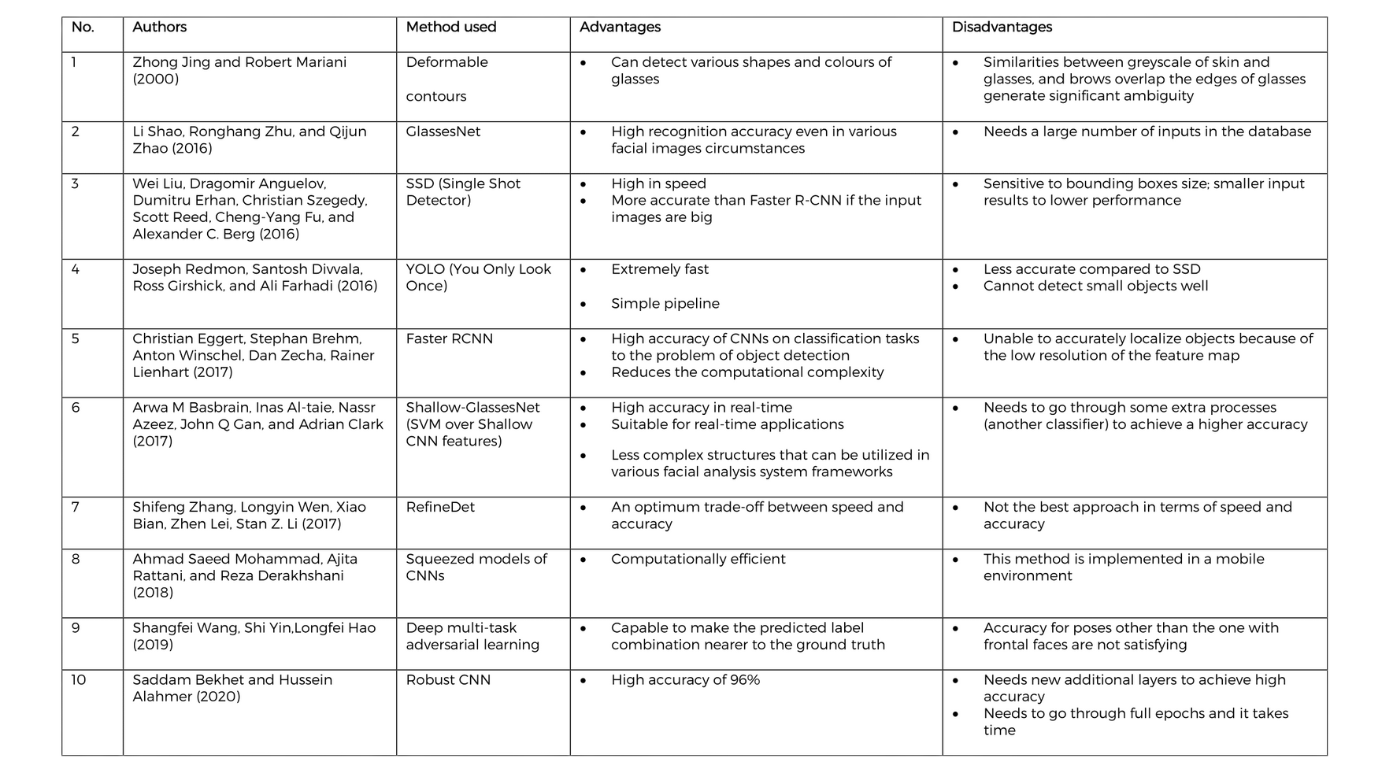

TABLE OF SUMMARY OF CURRENT TECHNIQUES

Slide 14
TABLE OF SUMMARY OF CURRENT TECHNIQUES
adopted and improved

Slide 15

OBJECTIVES
ANALYZE
ALGORITHMS
DEVELOP DETECTION SYSTEM
DEPLOY
MODEL
To analyze the different types of algorithms for safety eyewear detection based on their speed and accuracy
To develop an algorithm for safety eyewear detection that is suitable to be applied in the construction industry using machine learning
To deploy the trained model to a web application to be used in the construction site

Slide 16
CONTENT
Introduction
Literature
Review
Methodology
Problem Statement
Objective
Flowchart
Proposed Method
Theory
Method comparison

Slide 17
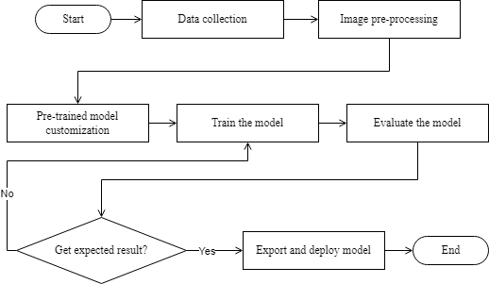

METHODOLOGY:
SYSTEM FLOWCHART

Slide 18
METHODOLOGY:
SYSTEM FLOWCHART

Slide 19
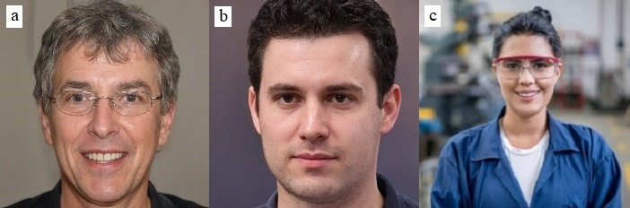
and b) Not wearing safety eyewear
c) Wearing safety eyewear

Slide 20
METHODOLOGY:
SYSTEM FLOWCHART

Slide 21
Images are cropped
2) Split into training and testing data

Slide 22
METHODOLOGY:
SYSTEM FLOWCHART

Slide 23
MobileNet model
Trained on large dataset
Many features extracted
IMPROVEMENT
- Transfer learning is utilized
Improve the accuracy

Slide 24
METHODOLOGY:
SYSTEM FLOWCHART

Slide 25
METHODOLOGY:
SYSTEM FLOWCHART

Slide 26
METHODOLOGY:
SYSTEM FLOWCHART

Slide 27
METHODOLOGY:
SYSTEM FLOWCHART

Slide 28







METHODOLOGY:
PROPOSED SYSTEM
Camera detects worker wearing safety eyewear
Camera connected to cloud to be used for commincation
Trained model deployed on smart camera at construction sites
Display outcome on web-based detection system
Worker
Camera detects worker not wearing safety eyewear

Slide 29
CONTENT
Introduction
Literature
Review
Methodology
Result & Demonstration
Problem Statement
Objective
Flowchart
Proposed Method
Theory
Method comparison

Slide 30
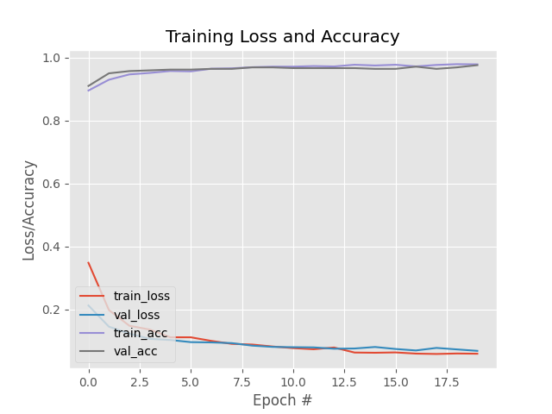
RESULT
Hyperparameter chosen:
20 epochs
53 iterations
Accuracy: 98%
Loss: <1%

Slide 31
OBJECTIVES
ANALYZE
ALGORITHMS
DEVELOP DETECTION SYSTEM
DEPLOY
MODEL
To analyze the different types of algorithms for safety eyewear detection based on their speed and accuracy
To develop an algorithm for safety eyewear detection that is suitable to be applied in the construction industry using machine learning
To deploy the trained model to a web application to be used in the construction site

Slide 32
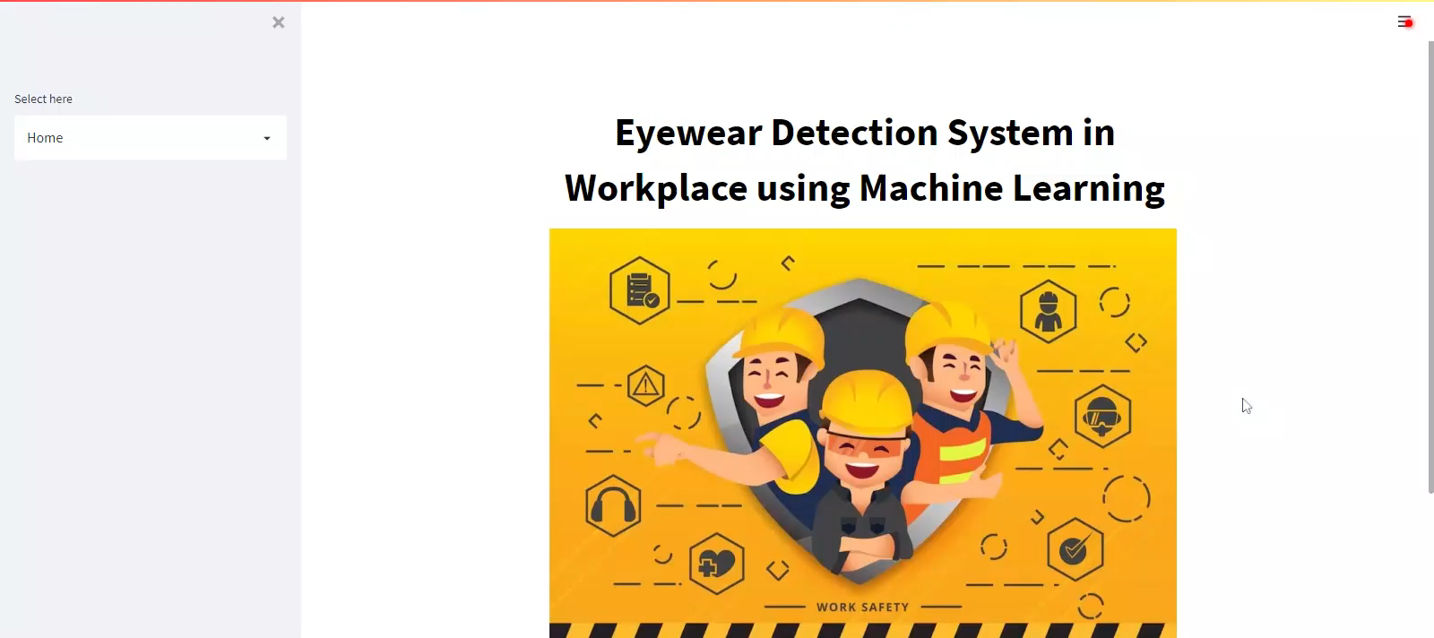
DEMONSTRATION

Slide 33
CONTENT
Introduction
Literature
Review
Methodology
Result & Demonstration
Conclusion & Future Work
Problem Statement
Objective
Flowchart
Proposed Method
Theory
Method comparison

Slide 34
CONCLUSION
ANALYZE
ALGORITHMS
DEVELOP DETECTION SYSTEM
DEPLOY
MODEL
To analyze the different types of algorithms for safety eyewear detection based on their speed and accuracy
To develop an algorithm for safety eyewear detection that is suitable to be applied in the construction industry using machine learning
To deploy the trained model to a web application to be used in the construction site

Slide 35
FUTURE WORK
IMPROVE DETECTION DISTANCE
- Merely 300 images of people wearing safety eyewear
- Almost 3000 images of people not wearing safety eyewear

Slide 36
FUTURE WORK
IMPROVE DETECTION DISTANCE
Distance between object and webcam increased
- Merely 300 images of people wearing safety eyewear
- Almost 3000 images of people not wearing safety eyewear
Misclassified

Slide 37
REFERENCES
[1] A. B. L. Abas, A. R. B. M. Said, M. A. B. A. Mohammed, and N. Sathiakumar, “Non-fatal occupational injuries among non-governmental employees in Malaysia,” Int J Occup Environ Health, vol. 17, no. 1, pp. 38–48, 2011, doi: 10.1179/107735211799031095.
[2] A. Ayob, A. Shaari, M. Zaki, and M. A. C. Munaaim, “Fatal occupational injuries in the Malaysian construction sector–causes and accidental agents,” 2018.
[3] T. Aksorn and B. Hadikusumo, “Critical success factors influencing safety program performance in Thai construction projects,” Safety Science, vol. 46, pp. 709–727, Jun. 2008, doi: 10.1016/j.ssci.2007.06.006.
[4] L. Shao, R. Zhu, and Q. Zhao, “Glasses Detection Using Convolutional Neural Networks,” Nov. 2016, pp. 711–719. doi: 10.1007/978-3-319-46654-5_78.
[5] D. and E. D. and S. C. and R. S. and F. C.-Y. and B. A. C. Liu Wei and Anguelov, “SSD: Single Shot MultiBox Detector,” in Computer Vision – ECCV 2016, 2016, pp. 21–37.
[6] C. Eggert, S. Brehm, A. Winschel, D. Zecha, and R. Lienhart, “A closer look: Small object detection in faster R-CNN,” in 2017 IEEE International Conference on Multimedia and Expo (ICME), 2017, pp. 421–426. doi: 10.1109/ICME.2017.8019550.
[7] I. B. Venkateswarlu, J. Kakarla, and S. Prakash, “Face mask detection using MobileNet and Global Pooling Block,” in 2020 IEEE 4th Conference on Information & Communication Technology (CICT), 2020, pp. 1–5. doi: 10.1109/CICT51604.2020.9312083.
[8] The Data Detective, “The 80/20 Split Intuition and an Alternative Split Method,” Towards Data Science, Jan. 31, 2020.
[9] B. Balakreshnan, G. Richards, G. Nanda, H. Mao, R. Athinarayanan, and J. Zaccaria, “PPE Compliance Detection using Artificial Intelligence in Learning Factories,” Procedia Manufacturing, vol. 45, pp. 277–282, 2020, doi: https://doi.org/10.1016/j.promfg.2020.04.017.

Slide 38
QNA SESSION
Thank you!

